Slide 1












FILE SYSTEM, AUTHENTICATION MODULES AND PROCESS MANAGEMENT

Slide 2


AGENDA
Users and Groups
Filesystem Management
Privilege Management
Process Management
Log Management
Service/Daemon Management

Slide 3







USERS AND GROUPS
A collection of users that share common permissions and access rights
An access account that enforces boundaries on what can and cannot be done in the system.
useradd
groupadd
ADMIN NON-ADMIN
passwd
ACCOUNTS
OPERATIONS
--home
userdel
CRUD user operation
Create a new user
Update the user details
Delete user
Read all users available
LOCK user
Set Password validity
Set User account validity period
USER
SYSTEM
groupmod
Account which allows a person to log into a Linux system and use its resources. Each user account has its own identity, permissions, and environment.
Accounts created for system processes and services rather than human users.
usermod
--maxdays
chage

Slide 4


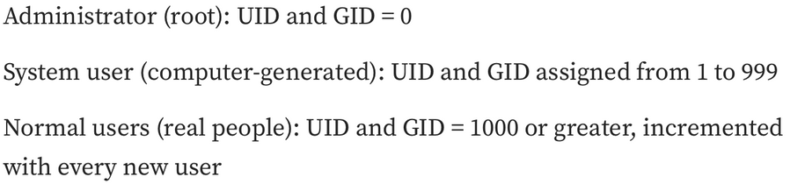


WHAT HAPPENS UNDER THE HOOD?
CREATING A USER
pavi user
pavi group
/home/pavi
/bin/bash

Slide 5

HANDS ON
Create a new user, and check the permissions of what the user can do ?
Modify a particular user
Use --help to check what we can do with that command
Delete user without removing the files
Lock user, set validity for the user account
Creating a group and adding a user to that group
Adding permissions to that group
Deleting a group

Slide 6
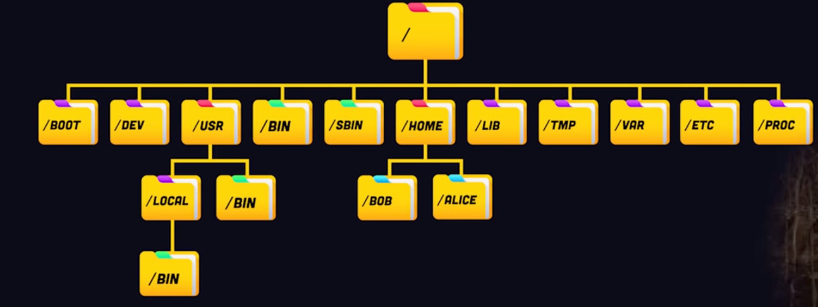
FILESYSTEMS
Everything in Linux is FILES

Slide 7

EVERYTHING IN LINUX IS FILES?
USERS
COMMANDS
NETWORK CONFIG
User details are stored in special system files (Have unique home directory as their workspace)
Passwords and login credentials are kept securely in config files.
Group memberships are also recorded in these files.
The operating system manages and protects these files.
System commands are executable files (ls, mkdir, etc., are stored as files)
These files contain instructions for specific operations.
When run, the system interprets and executes those instructions.
Network settings are stored in config files.
Interfaces (IP, subnet, gateway).
DNS resolver details are also recorded.
Files ensure easy management and consistency.
SYSTEM INFO
DEVICE FILES
System details are available through structured files.
Includes CPU specs, memory usage, uptime, and OS info.
These files make monitoring and management simple.
External devices are represented as files in Linux.
Includes hard drives, USBs, and other peripherals.
Managed and accessed via the standard file interface.
Provides seamless interaction with hardware.

Slide 8
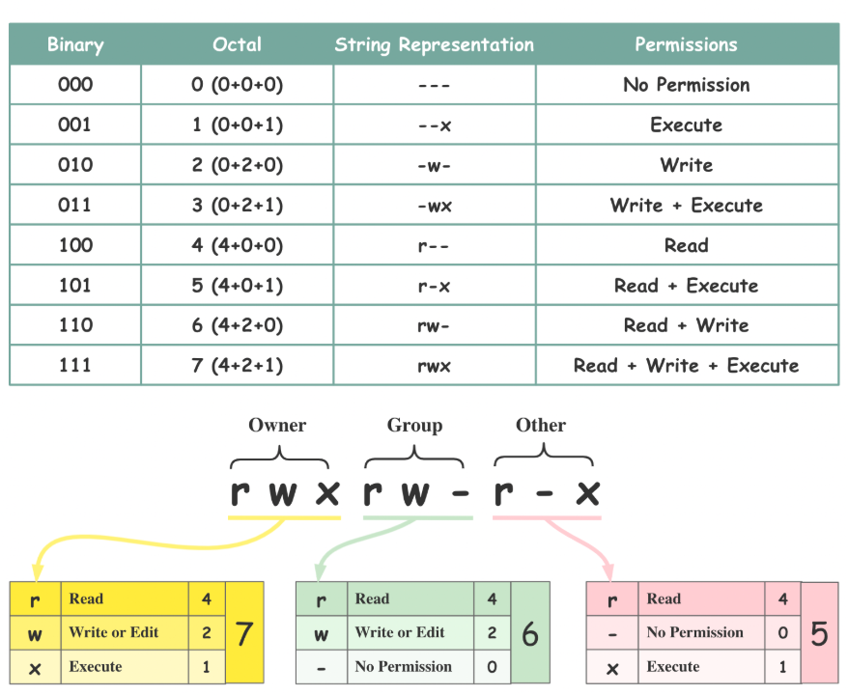

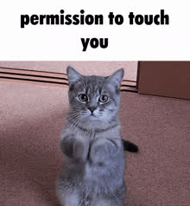
FILE PERMISSIONS

Slide 9

HANDS ON
pstree command
Showing the directories available
File permissions

Slide 10





PROCESS MANAGEMENT
WHAT IS A PROCESS?
how the system creates, schedules, monitors, and terminates processes
A running instance of a program / a program in execution
TYPE OF PROCESSES?
Foreground process
A foreground process is one that runs directly in the terminal and actively takes input from the user. You must wait until it finishes
Background process
A background process runs behind the scenes without blocking the terminal. You can continue using the terminal while it runs.

Slide 11
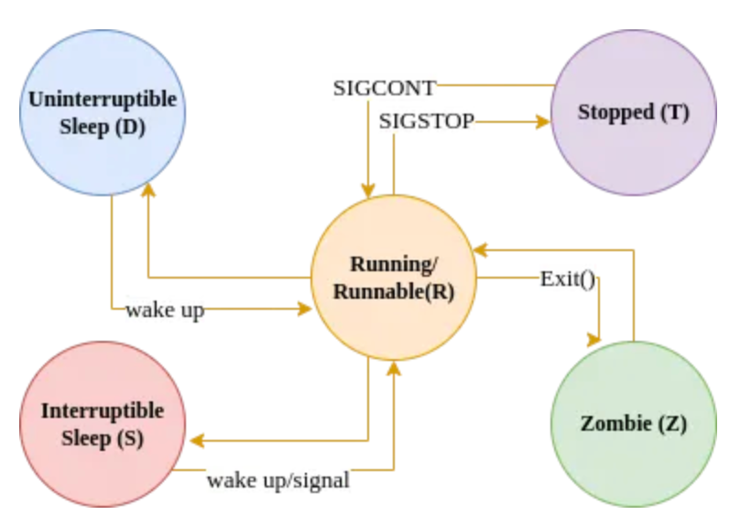
PROCESS STATES
Necessary resources are allocated to the Process
Once the process gets completed and gets a stop signal, the process goes into this state
The process waits for input (event / signal) from another process or input on a terminal from a user.
when the process waiting on something, means the process is in kernel space attempting to perform input given by the process.
The process is terminated/dead but entries/information for the process is still present in the process table

Slide 12
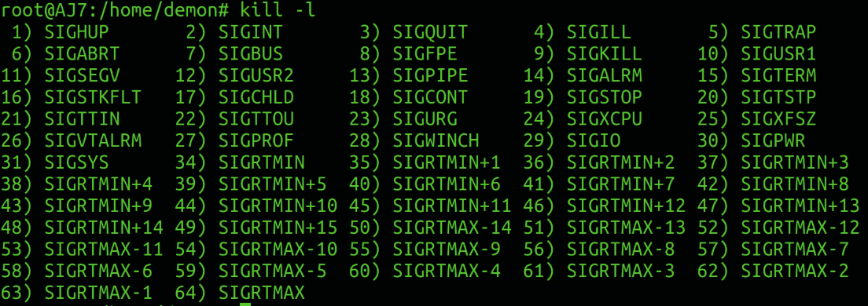
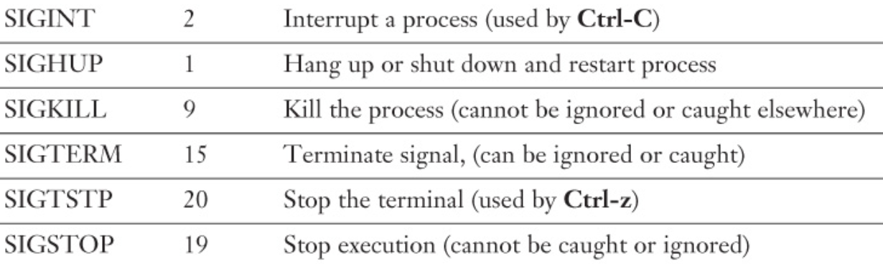
PROCESS COMMANDS
PROCESS SIGNALS
htop
ps
kill
pgrep
top
bg
ps aux
fg

Slide 13

HANDS ON
Check the running Processes
Kill a Process
background process and foreground process example
Process kill signals
signal 9
signal 20, ..

Slide 14
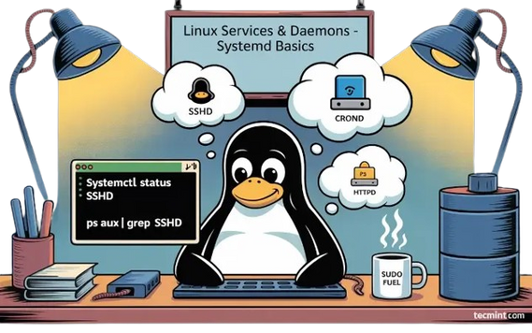

SERVICE/DAEMON MANAGEMENT
Handle system tasks like logging, networking, scheduling, or security
Usually start at system boot and keep running until shutdown
Background process in Linux that runs continuously and provides services to the system or users, without direct user interaction.
daemon names often end with a “d”
MASTER DAEMON
Starts, stops, enables, and disables services
init system and service manager for most modern Linux distributions
systemd
Provides journald for centralized logging and can be viewed with journalctl
systemd uses unit files (e.g., .service, .socket, .target) to define services, devices, mounts, etc.
systemctl is the command-line tool used to interact with systemd

Slide 15

CUSTOM SERVICE
Write the script you want to execute
create the systemd service file
Make sure the current user can access the script
Reload the service units and start the custom service
SECTIONS FOR CONFIGURING THE SERVICE FILE
Unit
Service
Install

Slide 16

HANDS ON
Running Daemon processes
Systemd services
Systemctl tool (service state management)
Journalctl tool usage

Slide 17

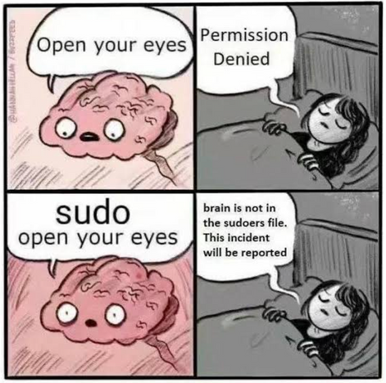
PRIVILEGE MANAGEMENT
Root
control and restrict user permissions so that users or processes can only perform actions they are authorized to.
root user (UID 0) has unrestricted access
PRINCIPLE OF LEAST PRIVILEGE
lets a user run specific commands as another user
switches user context to another account
sudo
su
/etc/passwd
/etc/shadow
sudoers file

Slide 18
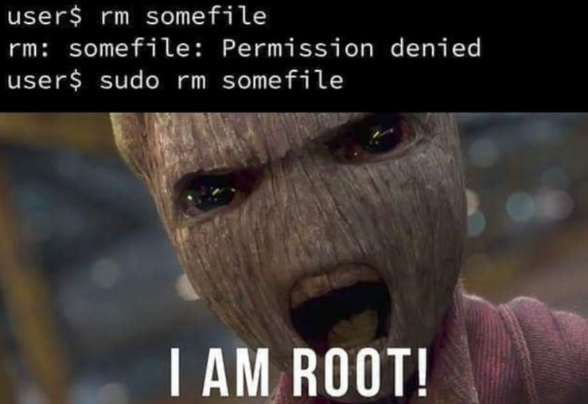
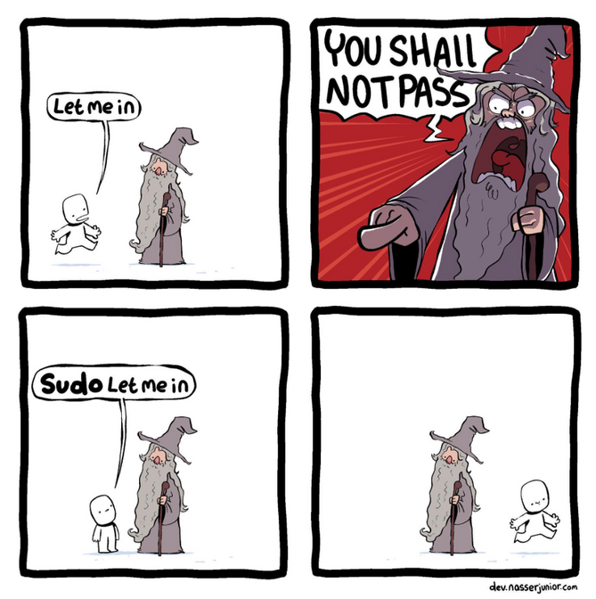
COMMAND QUEST
🛡️📦🔄⬇️
⚔️ ⚙️🔢
🛡️🔑🚫👤
😴 3️⃣0️⃣⏳ 🔙
📖👥🔍
🛡️ 🐕‍🦺 📜📂👀
👤➕💻
🔒 4️⃣4️⃣4️⃣ 📄

Slide 19

HANDS ON
using sudo to access the privilege files
switch user to access a particular file and check for that user permission
sudoers file - What? why?

Slide 20

LOG MANAGEMENT
WHAT ?
WHY ?
Process of collecting, storing, analyzing, monitoring, and rotating log files generated by the operating system, applications, and services
Troubleshooting & Debugging
System monitoring
Audit Trails
Security & Compliance, ..
LOG DIRECTORIES
COMMANDS
var/log
auth.log
sys.log
boot.log, etc
tail
multitail
less

Slide 21

HANDS ON
Look at the log directories available
Check the auth log file
boot log file
Push logs to tmp file
Tail, multitail, less command usage

